Slide 1
We've all been through that moment when we're so focused on what we're doing that we forget to eat, to sleep, we forget where we are and who we are, we forget everything.

Slide 2
I'm not a personal development coach, philosopher, psychologist, or neuroscientist;
I'm just a software developer.

Slide 3
THE ZONE FROM A PROGRAMMER’S PERSPECTIVE
by
RATOMBOTIANA Armand Judicael
Java developer, Ambatovy

Slide 4
It takes only 30 minutes or not
What is the zone or the state of flow
Me after being in the zone
The zone Insights Across Minds
Let’s go for a Javafx and springBoot demo project

Slide 5


Slide 6

But what exactly is 'The Zone' or 'Flow'?
The concept of 'flow' was popularized by Hungarian psychologist Mihaly Csikszentmihalyi.
He defined it as an optimal state where individuals become fully absorbed in an activity, losing track of time while experiencing profound satisfaction and heightened concentration. It's about being completely immersed and engaged in what you're doing.

Slide 7

Me after being in the zone

Slide 8
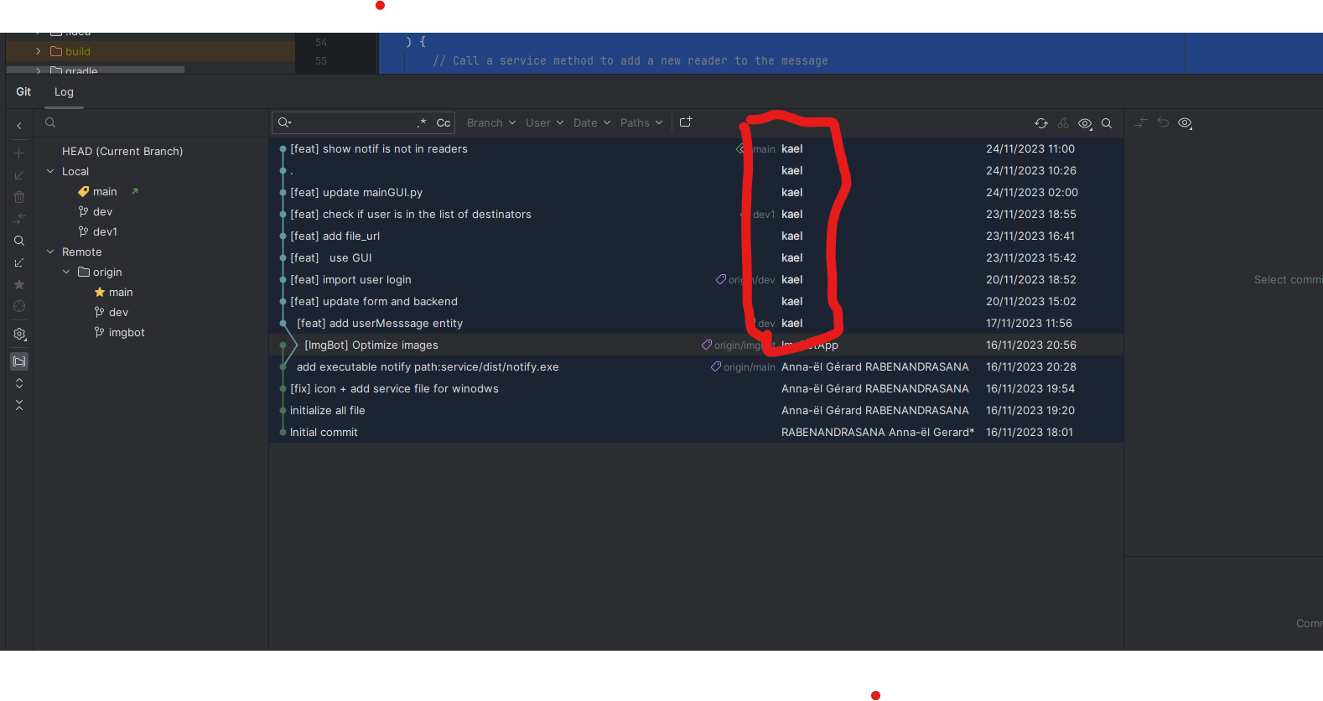
Me after being in the zone
I'm so confused !
Who wrote this code ?
NO , It’s not me !
Maybe the Holy Spirit !

Slide 9
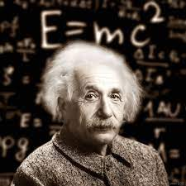
The Zone: Insights Across Minds

Slide 10


The Zone: Insights Across Minds
«When the game is on, I'm in my own little world. I don't hear the crowd, I don't see the coaches. I only see the ball and my teammates». Lionnel Messi
"When I'm in the zone, I feel I can do anything on the court. I'm not thinking, I'm just reacting. It's a magical feeling."
Roger Federer

Slide 11


The Zone: Insights Across Minds
" I'm trying to be the most immersed mixed martial artist, the most immersed martial artist of all time. " Jon Jones
" Everything slows down for me when I'm in there, especially when I'm in the zone. I can see everything that's going on. It's like the world slows down and I'm in control of everything. "
Cody Garbrandt

Slide 12
JAVAFX and SPRING BOOT
JavaFX is a Java-based framework for building sleek, modern, and interactive user interfaces across various platforms, offering versatile tools and APIs for creating visually appealing applications with rich multimedia and animation capabilities.
Spring Boot is a Java framework that simplifies and speeds up the development of powerful, standalone, and web-based applications by providing defaults and ready-to-use components, reducing setup overhead and allowing for quick creation of production-ready applications.
open your favorite code editor !!

Slide 13


Slide 14


